Slide 1
welcome

Slide 2
Sadik Ahmed
011151068
Ajmaree Sultana
011151081

Slide 3
3d solar system

Slide 4
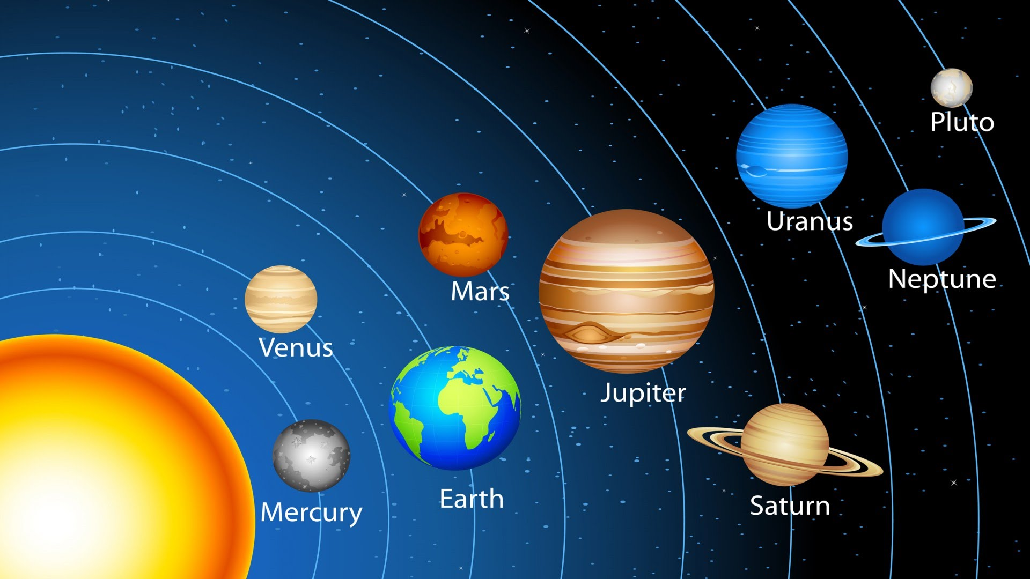
pupose
To understand the planets
Show a 3D view of solar sysytem

Slide 5
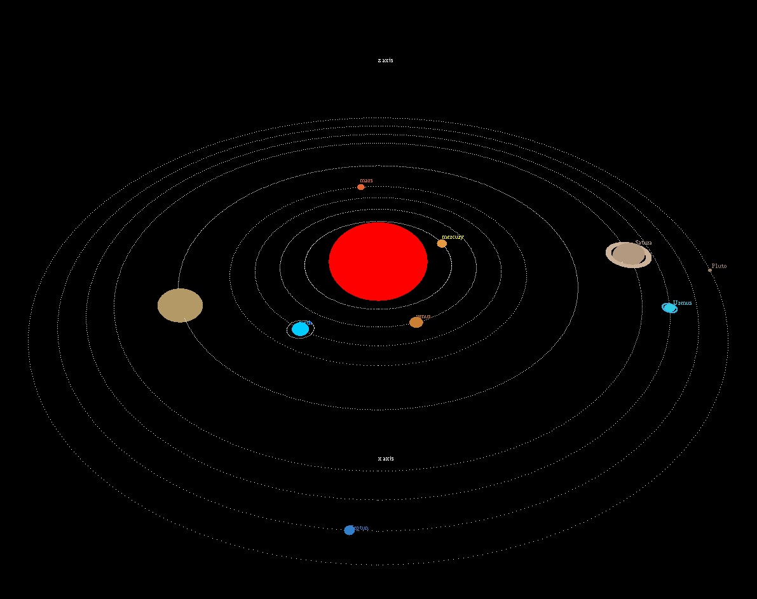

Slide 6
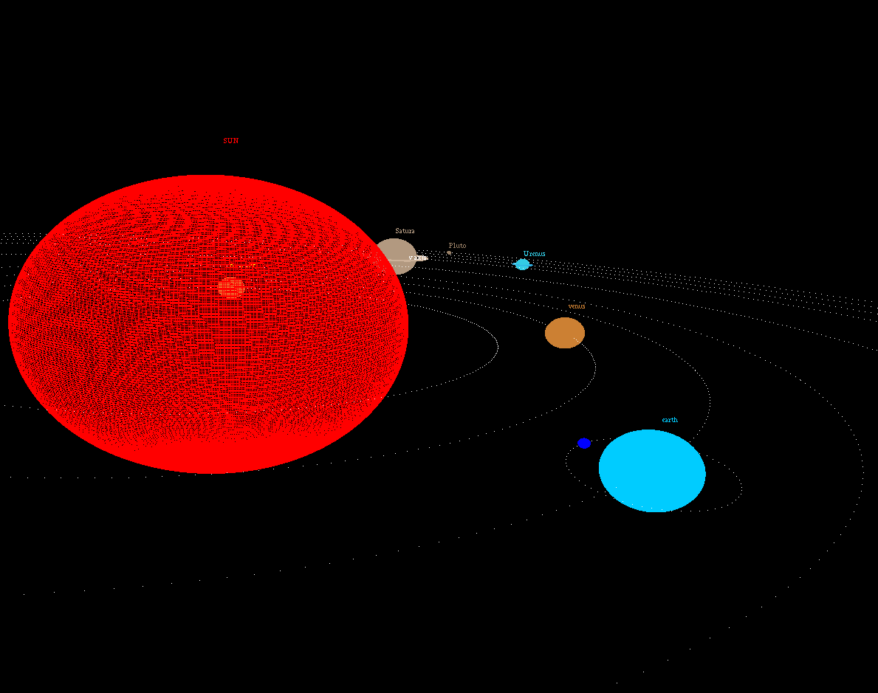

Slide 7
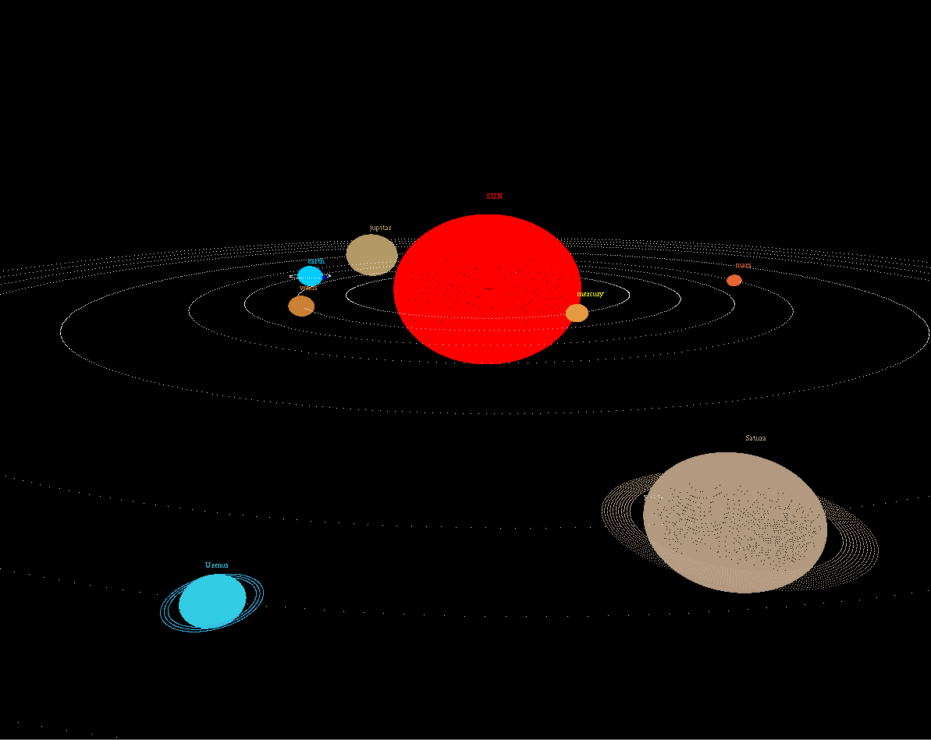

Slide 8


